Slide 1
Lecture 6.2 Correlation
Jibo He
Associate Professor
Wichita State University
Jibo.he@Wichita.edu

Slide 2
Chapter Outline
Describing a Correlation
The Direction of a Correlation
The Strength of a Correlation
Pearson Correlation Coefficient
Effect Size: The Coefficient of Determination
Hypothesis Testing: Testing for Significance
Assumptions of Tests for Linear Correlations
Limitations in Interpretation: Causality, Outliers, and Restriction of Range
Alternative to Pearson r: Spearman Correlation Coefficient
Alternative to Pearson r: Point Biserial Correlation Coefficient
Alternative to Pearson r: Phi Correlation Coefficient
APA in Focus: Reporting Correlations

Slide 3
Describing a Correlation
Correlation – statistical procedure used to describe the strength and direction of the linear relationship between two factors
In a correlation we treat each factor like a dependent variable and measure the relationship between the pair
i.e. texting during class (number of texts sent) and class performance (exam score)
A correlation can be used to:
(1) describe the pattern of data points for the values of two factors
(2) determine whether the pattern observed in a sample is also present in the population from which the sample was selected
In behavioral research, we mostly describe the linear (or straight line) relationship between two factors

Slide 4
Describing a Correlation (cont.)
Correlations are typically illustrated through a scatter plot
Scatter plots illustrates the relationship between two variables (x,y) plotted on the x and y axes of the graph, respectively.
Pairs of values for x and y are called data points
Data points plotted to see if a pattern emerges

Slide 5
The Direction of a Correlation
Correlation coefficient (r) – used to measure the strength and direction of the linear relationship, or correlation, between two factors.
The value of r ranges from -1.0 to +1.0
Values closer to ±1.0 indicate stronger correlations
The sign of the correlation coefficient (- or +) indicates only the direction or slope of the correlation

Slide 6
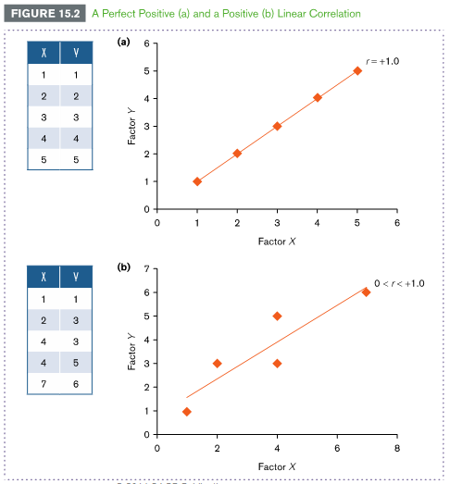
The Direction of a Correlation (cont.)
Positive correlation (0 < r < + 1.0) is a positive value of r
indicates that the values of two factors change in the same direction:
As the values of one factor increases, values of the second factor also increase; as the values of one factor decreases, values of the second factor also decrease

Slide 7
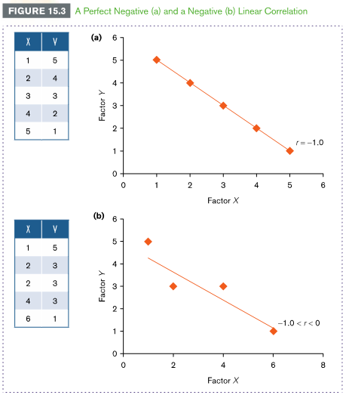
The Direction of a Correlation (cont.)
Negative correlation (-1.0 < r < 0) is a negative value of r
indicates that the values of two factors change in different directions:
meaning that as the values of one factor increases, values of the second factor decrease

Slide 8
The Strength of a Correlation
The strength of a correlation reflects how consistently scores for each factor change
When plotted in a graph, scores are more consistent the closer they fall to a regression line
Zero correlation means there is no linear pattern between two factors
Perfect correlation occurs when each data point falls exactly on a straight line
Regression line – the best fitting straight line to a set of data points. A best fitting line is the line that minimizes the distance of all data points that fall from it

Slide 9
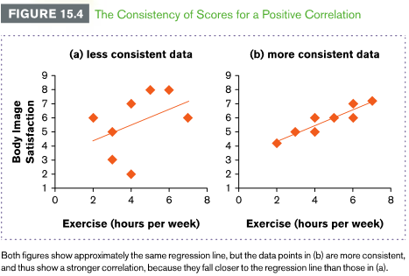
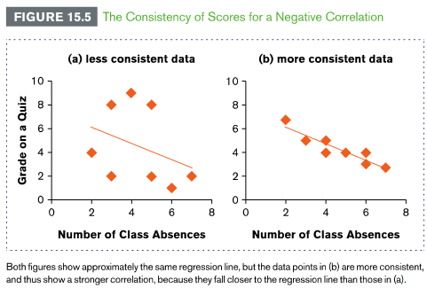
The Strength of a Correlation (cont.)

Slide 10
Pearson Correlation Coefficient
The Pearson (product moment) correlation coefficient (r) – used to measure the direction and strength of the linear relationship of two factors in which the data for both factors are measured on an interval or ratio scale of measurement
Pearson
The value in the numerator reflects the extent to which values on the x-axis (X) and y-axis (Y) vary together
The extent to which the values of two factors vary together is called covariance
The extent to which values of X and Y vary independently, or separately, is placed in the denominator

Slide 11
Example 15.1: Pearson Correlation Coefficient
A health psychologist measures the relationship between mood and eating. She measures mood using a 9-point rating scale, where higher ratings indicate better mood.
She measures eating as the average number of daily calories that five participants consumed in the previous week.
The results are listed in Figure 15.8.
Find the Pearson correlation coefficient using these data.

Slide 12
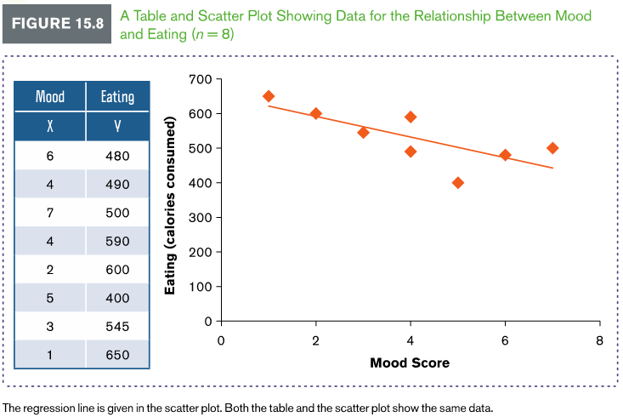
Example 15.1: Pearson Correlation Coefficient (cont.)

Slide 13
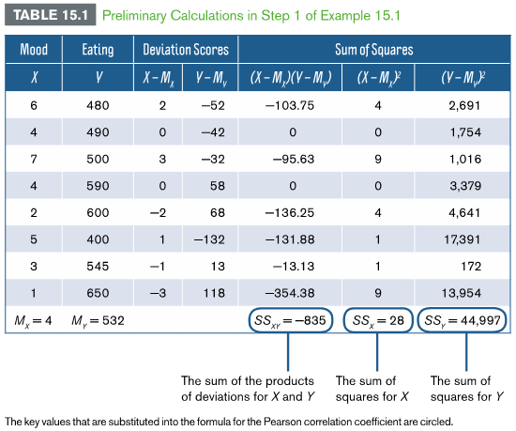
Example 6.1: Compute Preliminary Calculations
Step 1: Compute preliminary calculations.
We begin by making the preliminary calculations listed in Table 15.1. The signs (+ and -) of the values we measure for each factor are essential to making accurate computations. The goal is to find the sum of squares needed to complete the formula for r.

Slide 14
Example 6.1: Compute the Pearson Correlation Coefficient
Step 2: Compute the Pearson correlation coefficient (r)
We computed each required computation for the formula in Step 1 (Table 15.1)
Compute average X and Y score
Subtract each score from its respective mean
Multiply and sum the deviation scores for X
Multiply and sum the deviation scores for Y
Substitute these values into the formula to compute the Pearson correlation coefficient

Slide 15
Effect Size: The Coefficient of Determination
Coefficient of determination ( r² or R² ) – mathematically equivalent to eta-squared, and is used to measure the proportion of variance of one factor (Y) that can be explained by known values of a second factor (X)
In Example 6.1, the coefficient of determination for the data is:
We conclude that about 55% of the variability in calories consumed can be explained by participant’s ratings of their mood.

Slide 16
Hypothesis Testing: Testing for Significance
Step 1: State the hypotheses
Mood is not related to eating in the population
Mood is related to eating in the population
Step 2: Set the criteria for a decision
We will compute a two-tailed test at a .05 level of significance
df for a correlation are n – 2
df for Example 6.1 are 8 – 2 = 6
Critical values found in Table B.5 (appendix B) = ±.707
Step 3: Compute the test statistic
The correlation coefficient r is the test statistic for the hypothesis test (previously computed)
Step 4: Make a decision
Because exceeds the critical values (r = ± 0.707), reject the null hypothesis
The observed between mood and eating reflects a relationship between the two factors in the population.

Slide 17
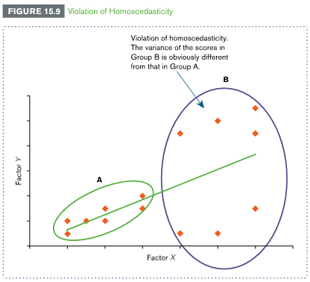
Assumptions of Tests for Linear Correlations (cont.)
Homoscedasticity – assumption that there is an equal (“homo”) variance or scatter (“scedasticity”) of data points dispersed along the regression line
Linearity – assumption that the best
way to describe a pattern of data
is using a straight line

Slide 18
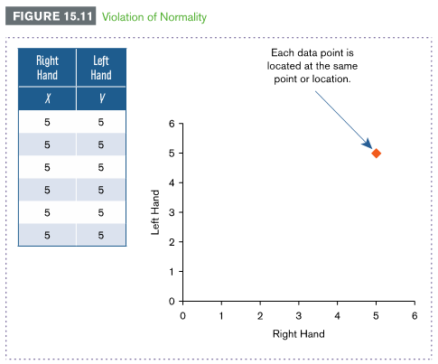
Assumptions of Tests for Linear Correlations
Normality – assumption that data points are normally distributed, such that X and Y scores for two factors form a bivariate normal distribution and:
1. The population of X scores is normally distributed
2. The population of Y scores is normally distributed
3. For each X score, the distribution of Y scores is normally distributed
4. For each Y score, the distribution of X scores is normally distributed

Slide 19
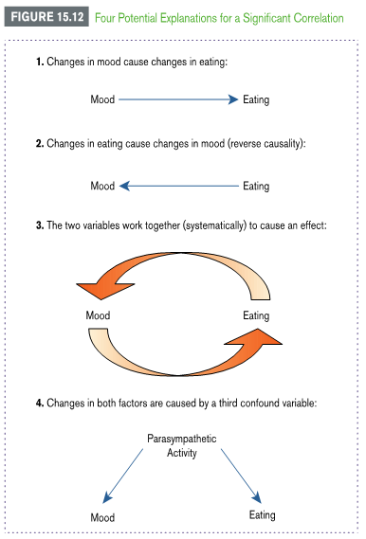
Limitations in Interpretation: Causality, Outliers, and Restriction of Range
Causality
A significant correlation does not show that one factor causes changes in a second factor
Reverse causality is a problem that arises when the direction of causality between two factors can be in either direction
Factors could be systematic; they work together to cause change
A confound variable, or third variable, is an unanticipated variable that could be causing changes in one or more measured variables

Slide 20
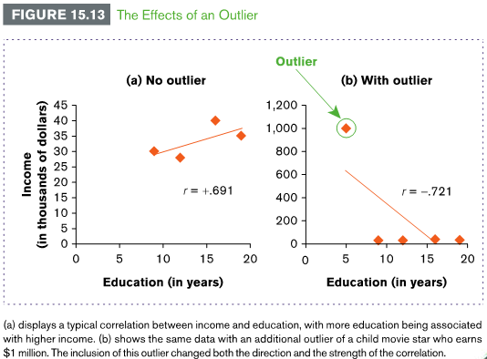
Limitations in Interpretation: Causality, Outliers, and Restriction of Range (cont.)
Outliers
An outlier is a score that falls substantially above or below most other scores in a data set
Outliers can obscure the relationship between two factors by altering the direction and strength of an observed correlation

Slide 21
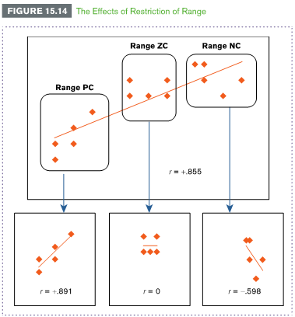
Limitations in Interpretation: Causality, Outliers, and Restriction of Range (cont.)
Restriction of range
A problem that arises when the range of data for one or both correlated factors in a sample is limited or restricted, compared to the range of data in the population from which the sample was selected
When interpreting a correlation, it is important to avoid making conclusions about relationships that fall beyond the range of data measured

Slide 22
Spearman Correlation Coefficient
For non-parametric data, Spearman rank correlation rho

Slide 23
Alternative to Pearson r: Spearman Correlation Coefficient
Spearman rank-order correlation coefficient (r_{s}) or Spearman’s rho – used to measure the direction and strength of the linear relationship of two ranked factors on an ordinal scale or measurement
D is the difference between ranks of Factor X and Factor Y, and n is the number of pairs of ranks
Will still produce a value between -1 and +1

Slide 24
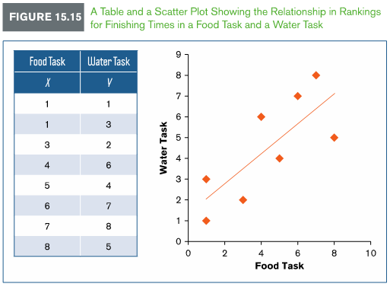
Example 15.2: Spearman Correlation Coefficient
To measure motivation, an animal behavior psychologist ranked the time it took six mice that were deprived of food and water to complete two tasks: one reinforced with food (food task) and a second with water (water task). He ranked the mice based on their times, with the fastest time being ranked 1 and so on for each test. The researcher hypothesized that mice would finish at a similar rank for each test. Figure 15.15 displays the results of this hypothetical study

Slide 25
Example 15.2: Average Tied Ranks
Step 1: Average tied ranks
Assume ranks are in order. Treat tied ranks as if they are not tied
Assume that one mouse finished first (rank 1) and another finished second (rank 2)
Compute the mean of the tied ranks. Average the tied ranks as if they are not tied
Assign this average rank, 1.5, to both mice that finished first
Shift the remaining ranks accordingly
The last rank should equal n or the total number of ranks recorded.

Slide 26
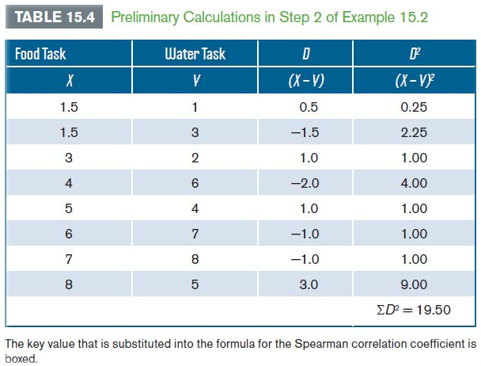
Example 15.2: Compute Preliminary Calculations
Step 2: Compute preliminary calculations.

Slide 27
Example 15.2: Compute the Spearman Correlation Coefficient
We can also test for significance
Use a two-tailed test at a .05 level of significance
Because n = 8, the critical values are ± 0.738
The Spearman correlation coefficient (0.768) exceeds the critical value r_{s}
Decision: Reject the null hypothesis
Step 3: Compute the Spearman correlation coefficient (r_{s})

Slide 28
Spearman Correlation Coefficient in R
FoodTask <-c(1,1,3,4,5,6,7,8)
WaterTask<-c(1,3,2,6,4,7,8,5)
cor.test(FoodTask, WaterTask, method="spearman")
data: FoodTask and WaterTask
S = 19.616, p-value = 0.02652
alternative hypothesis: true rho is not equal to 0
sample estimates:
rho
0.7664808

Slide 29
Point Biserial Correlation Coefficient

Slide 30
Alternative to Pearson r: Point Biserial Correlation Coefficient
Point biserial correlation coefficient ( ) – used to measure the direction and strength of the linear relationship of one factor that is continuous (on an interval or ratio scale of measurement) and a second factor that is dichotomous (on a nominal scale of measurement)
where
p and q are the proportions of scores for each level of the dichotomous variable, is the standard deviation of Y scores (scores for the continuous factor), and n is the number of pairs of scores measured

Slide 31
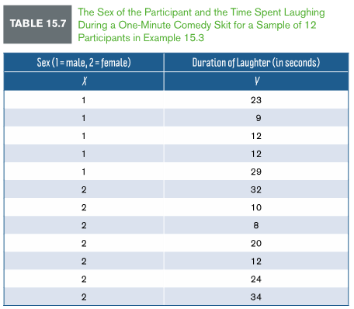
Example 15.3: Point Biserial Correlation Coefficient
In a study investigating how gender is related to perceptions of humor, 12 participants observed a videotape of a female comedian perform a one-minute comedy skit.
The time spent laughing (in seconds) was recorded for each participant.
The gender of the participant (male, female) is the dichotomous factor, and the time spent laughing during the skit is the continuous factor.
Table 15.7 shows the results from this hypothetical study with Step 1 already completed

Slide 32
Example 15.3: Code the Dichotomous Factor
Step 1: Code the dichotomous factor
Men are coded as 1 and women are coded as 2
Proportion of men is
Proportion of women is
p and q should sum to 1.0

Slide 33
Example 15.3: Compute Preliminary Calculations
Step 2: Compute preliminary calculations.

Slide 34
Example 15.3: Compute the Point Biserial Correlation Coefficient
Step 3: Compute the point biserial correlation coefficient ( ):
[1]
[2]
The direction of the correlation is not meaningful because gender is dichotomous.
To test for significance, compute the two-independent sample t test (Chapter 9) by making each dichotomous factor (men, women) a separate group and duration of laughter the dependent variable in each group
t = .522, does not exceed critical value of ±2.228
Using the point biserial correlation coefficient, a correlation between gender and duration of laughter was not significant, p > .05

Slide 35
Biserial Correlation Coefficient in R
#install.packages("ltm")
library(ltm)
sex<-c(1,1,1,1,1,2,2,2,2,2,2,2)
LaughterDuration<-c(23,9,12,12,29,32,10,8,20,12,24,34)
biserial.cor(LaughterDuration,sex, level = 2)

Slide 36
Phi Correlation Coefficient

Slide 37
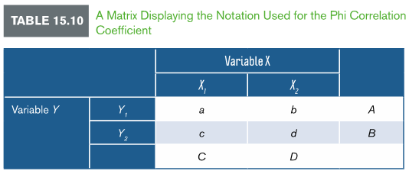
Alternative to Pearson r: Phi Correlation Coefficient
Phi correlation coefficient ( ) is used to measure the direction and strength of the linear relationship of two dichotomous factors on a nominal scale of measurement
The notation used for the phi correlation coefficient is taken from the outcomes in a 2 x 2 matrix
The formula for the phi correlation coefficient using this notation is:

Slide 38
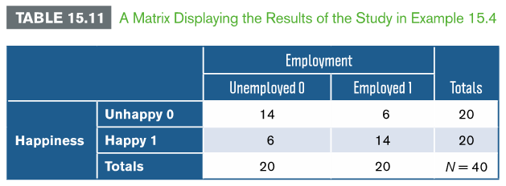
Example 15.4: Phi Correlation Coefficient
A researcher wants to determine the relationship between employment (employed, unemployed) and happiness (happy, unhappy) using a sample of 40 participants. The number of participants in each category was recorded. The 2 x 2 matrix in Table 15.11 shows the results of this hypothetical study

Slide 39
Example 15.4: Phi Correlation Coefficient (cont.)
To compute the phi correlation coefficient, substitute the frequencies (or number of participants) in each cell of the matrix into the formula for the phi correlation:
We conclude people who are happy tend to be employed and people who are unhappy tend to be unemployed

Slide 40
Phi Correlation Coefficient in R
# https://personality-project.org/r/html/phi.html
# require package psych
#install.packages("psych")
library(psych)
x <- matrix(c(14,6,6,14),ncol=2)
phi(x)
Notes:
https://personality-project.org/r/html/phi.html

Slide 41
Example 15.4: Phi Correlation Coefficient and Significance
To determine significance:
Convert the value of r to (introduced in Ch. 17)using the following equation:
For this test, the df are always equal to 1
If you compute a two-tailed test at a .05 level of significance, then the critical value is 3.84
Because the chi-square statistic (6.40) exceeds the critical value, we reject the null hypothesis

Slide 42
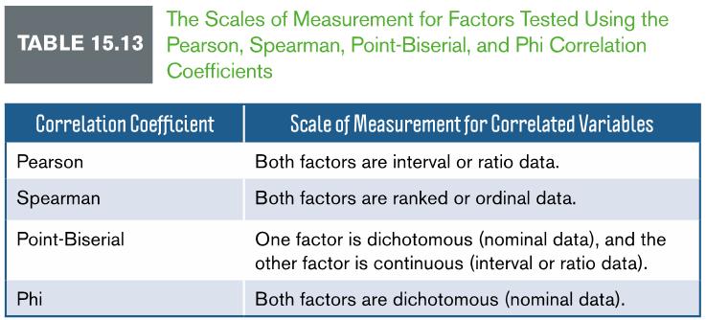
Review of Correlation Coefficients
All correlation coefficients are derived from the Pearson correlation

Slide 43
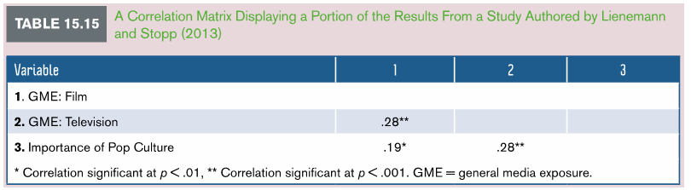
APA in Focus: Reporting Correlations
To summarize correlations, report the strength, direction, and p value for each correlation coefficient
Sample size and effect size should also be reported
Means and standard error or SDs can be summarized in a figure or table in the main text
When we compute many correlations in a single study, report each correlation coefficient in a table called a correlation matrix

